Slide 1
Distance Vector Routing Protocols

Slide 2
Objectives
Identify the characteristics of distance vector routing protocols.
Describe the network discovery process of distance vector routing protocols using Routing Information Protocol (RIP).
Describe the processes to maintain accurate routing tables used by distance vector routing protocols.
Identify the conditions leading to a routing loop and explain the implications for router performance.
Recognize that distance vector routing protocols are in use today

Slide 3
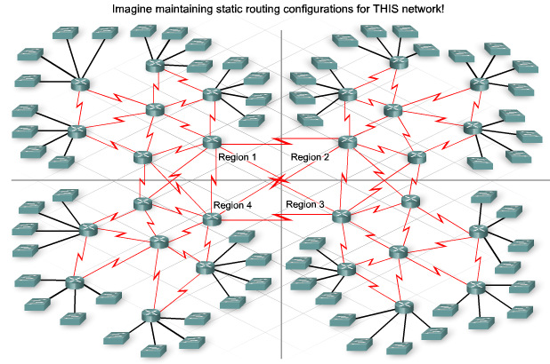
Why dynamic routing protocol

Slide 4
Distance Vector Routing Protocols
Examples of Distance Vector routing protocols:
    Routing Information Protocol (RIP) v1,2
    Interior Gateway Routing Protocol (IGRP)
    Enhanced Interior Gateway Routing Protocol (EIGRP)

Slide 5
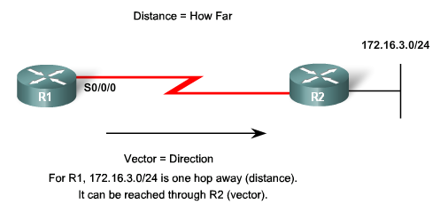
Distance Vector Routing Protocols
Distance Vector Technology
  The Meaning of Distance Vector:
    A router using distance vector routing protocols knows 2 things:
        Distance to final destination
        Vector, or direction, traffic should be directed

Slide 6
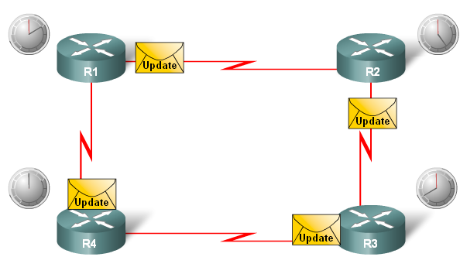
Distance Vector Routing Protocols
Characteristics of Distance Vector routing protocols:
  Periodic updates
  Broadcast updates
  Entire routing table is included into routing update

Slide 7
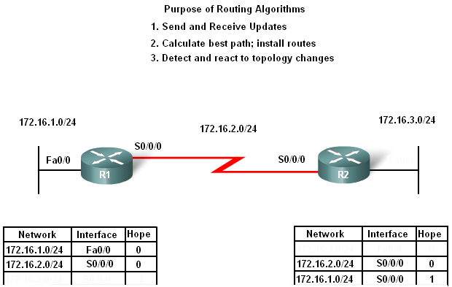
Distance Vector Routing Protocols
Routing Protocol Algorithm:
-Defined as a procedure for accomplishing a certain task

Slide 8
Distance Vector Routing Protocols
Routing Protocol Characteristics
  Criteria used to compare routing protocols includes
    Time to convergence
    Scalability
    Resource usage
    Implementation & maintenance

Slide 9
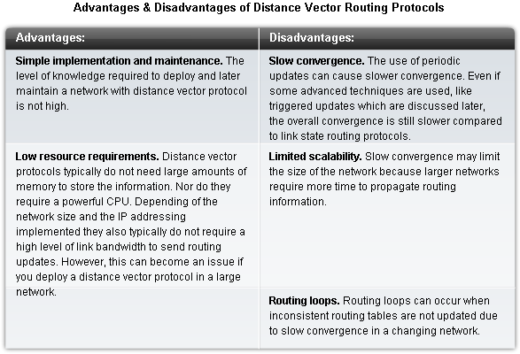
Distance Vector Routing Protocols

Slide 10
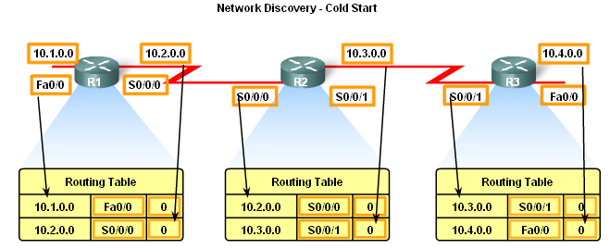
Network Discovery
Router initial start up
  -Initial network discovery
    Directly connected networks are initially placed in routing table

Slide 11
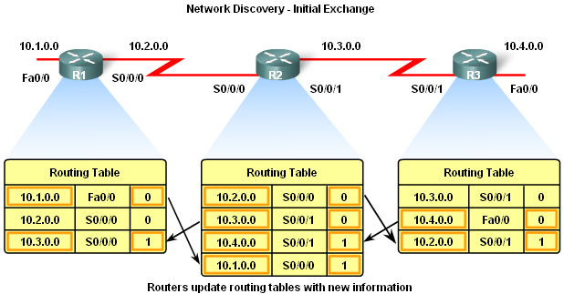
Network Discovery
Initial Exchange of Routing Information
  If a routing protocol is configured then
-Routers will exchange routing information
Routing updates received from other routers
-Router checks update for new information
      If there is new information:
-Metric is updated
-New information is
stored in routing table

Slide 12
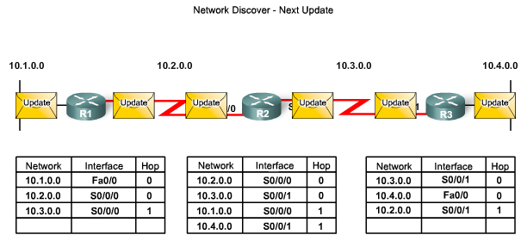
Network Discovery
Exchange of Routing Information
  Router convergence is reached when
-All routing tables in the network contain the same network information
  Routers continue to exchange routing information
-If no new information is found then Convergence is reached

Slide 13
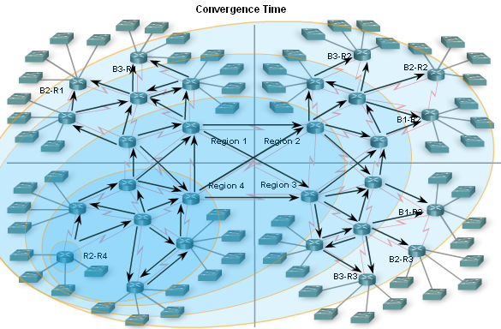
Network Discovery
Convergence must be reached before a network is considered completely operable
Speed of achieving convergence consists of 2 interdependent categories
-Speed of broadcasting routing information
-Speed of calculating routes

Slide 14
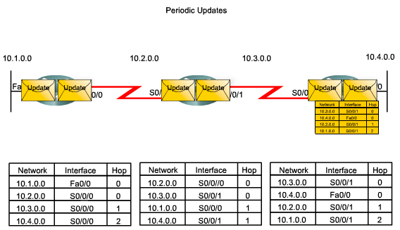
Routing Table Maintenance
Periodic Updates: RIPv1 & RIPv2
These are time intervals in which a router sends out its entire routing table.

Slide 15
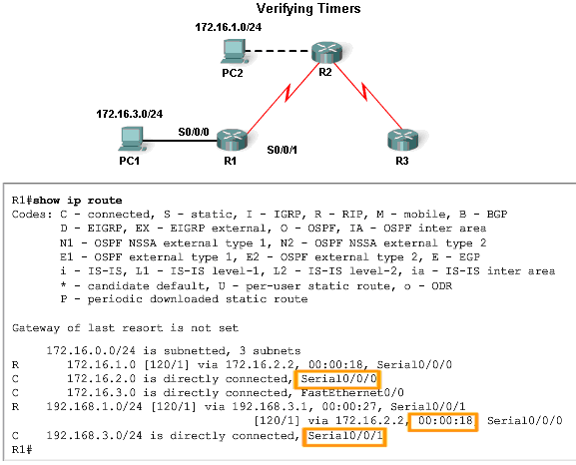
Routing Table Maintenance
RIP uses 4 timers
  -Update timer
  -Invalid timer
  -Hold-down timer
  -Flush timer

Slide 16
Routing Table Maintenance
Invalid Timer:- If an update has not been received to refresh an existing route after 180 seconds (the default), the route is marked as invalid by setting the metric to 16. The route is retained in the routing table until the flush timer expires.
Flush Timer:- By default, the flush timer is set for 240 seconds, which is 60 seconds longer than the invalid timer. When the flush timer expires, the route is removed from the routing table.

Slide 17
Update, holddown & flush timers
update
about certain network
update
about certain network
update
about certain network
180 sec
180 sec
180 sec
Invalid timer
Holddown timer
Flush timer

Slide 18
Routing Table Maintenance
EIRPG routing updates are
-Partial updates (The Update Contain only the changed
Routes)
-Triggered by topology changes (Once a change happen,
Update is sent)
-Bounded (Update sent only to Routers who need it )
-Non periodic

Slide 19
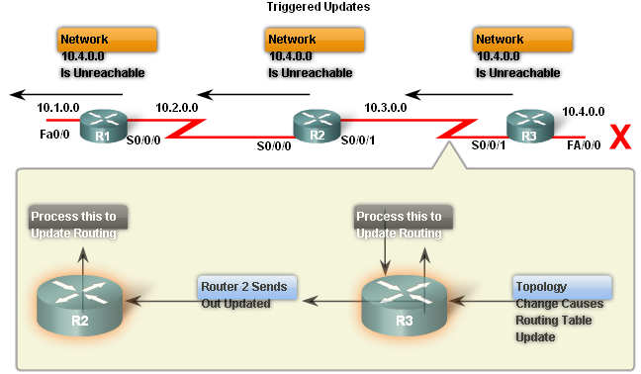
Routing Table Maintenance
Triggered Updates
  Conditions in which triggered updates are sent
-Interface changes state
-Route becomes unreachable
-Route is placed in routing table

Slide 20
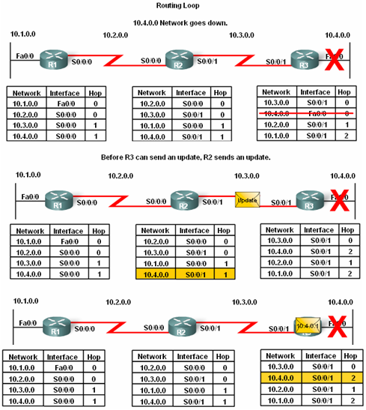
Routing Loops
Routing loops are
A condition in which a packet is continuously transmitted within a series of routers without ever reaching its destination.
See animation 4.4.1.1

Slide 21
Routing Loops
Routing loops may be caused by:
-Incorrectly configured static routes
-Incorrectly configured route redistribution
-Slow convergence
-Incorrectly configured discard routes
Routing loops can create the following issues
-Excess use of bandwidth
-CPU resources may be strained
-Network convergence is degraded
-Routing updates may be lost or not processed in a timely manner

Slide 22
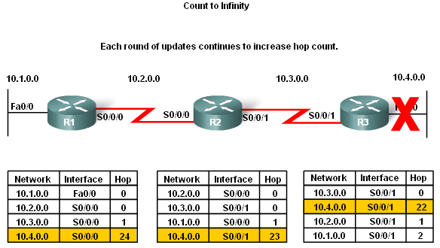
Routing Loops problems
Count to Infinity
This is a routing loop whereby packets bounce infinitely around a network.

Slide 23
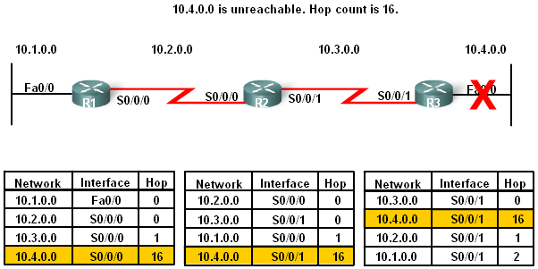
Routing Loops problems
Distance Vector routing protocols set a specified metric value to indicate infinity
Once a router “counts to infinity” it marks the route as unreachable

Slide 24
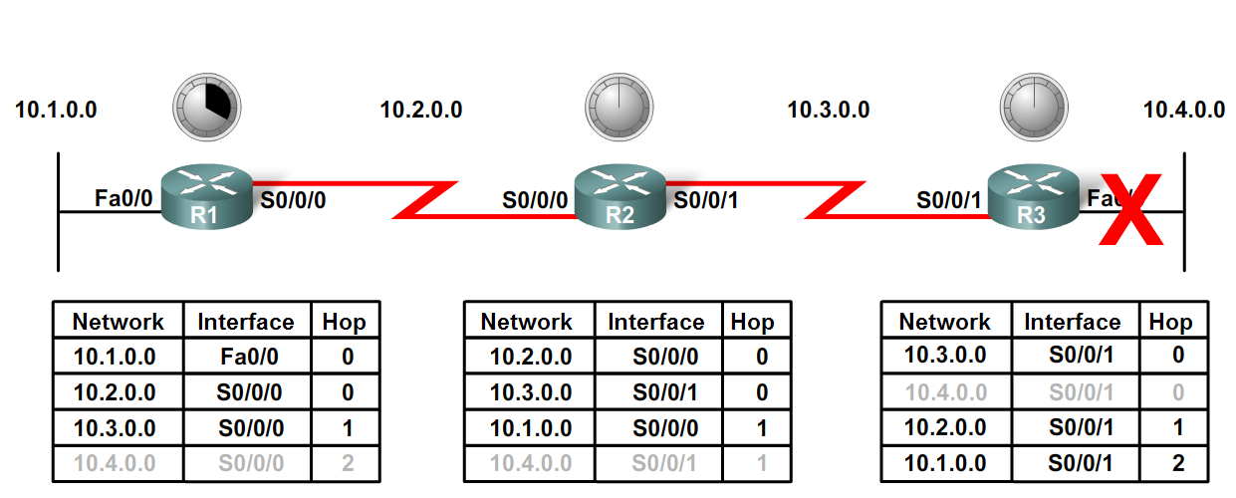
Routing Loops
Preventing loops with holddown timers
  -Holddown timers allow a router to not accept any changes to a route for a specified period of time.
  -Point of using holddown timers
    Allows routing updates to propagate through network with the most current information. Holddown timers are used to prevent regular update messages from inappropriately reinstaling a route that may have gone bad.

Slide 25
Routing Loops
Holddown Timer. This timer stabilizes routing information and helps prevent routing loops during periods when the topology is converging on new information. Once a route is marked as unreachable (Invalid), it must stay in holddown long enough for all routers in the topology to learn about the unreachable network. By default, the holddown timer is set for 180 seconds.

Slide 26
Update, holddown & flush timers
Last update
about certain network
180 sec
180 sec
180 sec
Invalid timer
Holddown timer
Flush timer

Slide 27
Update, holddown & flush timers
Update about the same network with metric=16
Last update about certain network
180 sec
180 sec
180 sec
Invalid timer
Holddown timer
Flush timer

Slide 28
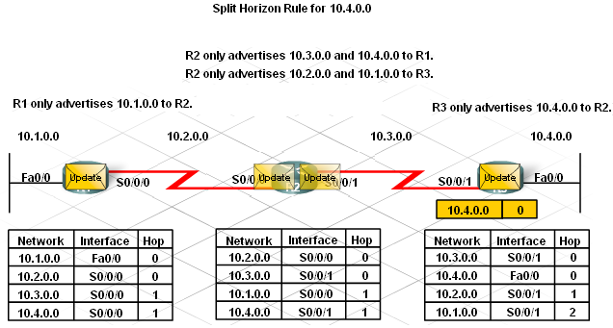
Routing Loops
The Split Horizon Rule is used to prevent routing loops
Split Horizon rule:
A router should not advertise a network through the interface from which the update came.

Slide 29
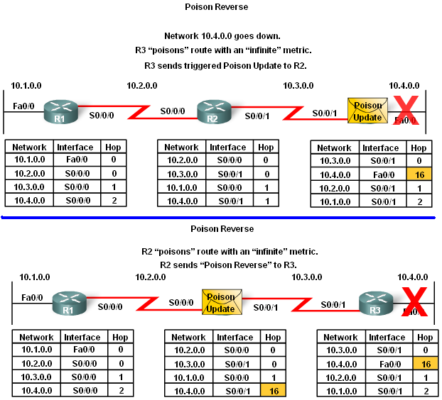
Routing Loops
Split horizon with poison reverse
The rule states that once a router learns of an unreachable route through an interface, advertise it as unreachable back through the same interface

Slide 30
Route poisoning & Poison reverse
Route poisoning: sending update about the unreachable network with setting the metric (hop count) to 16
Poison reverse: after receiving the poisoned update the router will suspend the split horizon rule and send the same poisoned update again across the same interface then resume split horizon rule again

Slide 31
Routing Loops
IP & TTL
  Purpose of the TTL field
The TTL field is found in an IP header and is used to prevent packets from endlessly traveling on a network
How the TTL field works
-TTL field contains a numeric value
The numeric value is decreased by one by every router on the route to the destination.
If numeric value reaches 0 then Packet is discarded.

Slide 32
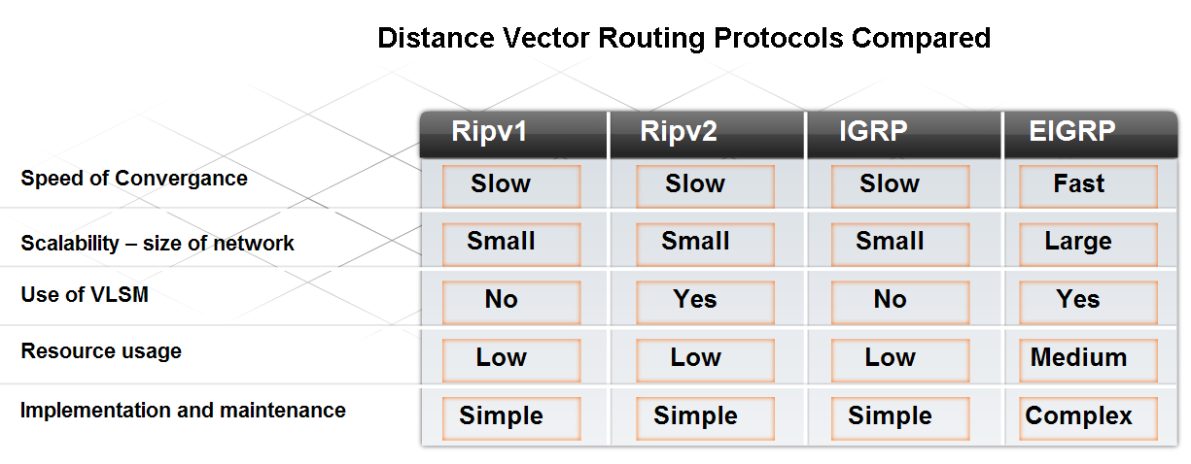
Routing Protocols Today
Factors used to determine whether to use RIP or EIGRP include
-Network size
-Compatibility between models of routers
-Administrative knowledge

Slide 33
Routing Protocols Today
RIP
  Features of RIP:
-Supports split horizon & split horizon with poison reverse
-Capable of load balancing
-Easy to configure
-Works in a multi vendor router environment

Slide 34
Routing Protocols Today
EIGRP
  Features of EIGRP:
-Triggered updates
-EIGRP hello protocol used to establish neighbor adjacencies
-Supports VLSM & route summarization
-Use of topology table to maintain all routes
-Classless distance vector routing protocol
-Cisco proprietary protocol

